Slide 1
A Formal Semantics for Complete UML State Machines with Communications Shuang Liu¹, Yang Liu², Étienne André³, Christine Choppy³, Jun Sun⁴, Bimlesh Wadhwa¹ and Jin Song Dong¹
Notes:
I am going to present the work :
That is done with advises my supervisors Dr. Bimlesh and Dr. Dong Jin Song
As well as our collaborators.

Slide 2
Background
(OMG) UML state machine is semi-formal language, with formal syntax and informal semantics.
Unclarities in the OMG UML2.0 state machines specification have been reported [FSKR’05].
The importance of providing formal semantics for UML state machines:
Facilitate precise and efficient communications.
Yield more rigorous and consistent models.
Enable automatic verification, which uncovers of design flaws in an early stage and dramatically reduces development costs.
Notes:
UML state machines is a semi-formal language with a formally defined syntax and informally specified semantics, which is Documented in natural language. Fecher and his collaborators have reported 29 unclarities in UML 2.0 state machines Specifications in 2005.
The importance of providing formal semantics for UML state machines has been realized by researchers for a long time
and here we list 3 points.
Firstly, it enables precise and efficient communications between system designers, developers and stake holders.
Secondly, it yields more rigorous and consistent models, which have better maintainability.
Lastly and most importantly, it enables automatic verifications techniques such as model checking techniques to be
Applied to UML state machines, which can uncover design flaws in an early stage and dramatically reduces the development cost.
Unclarity: inconsistency, ambiguity, incompleteness and equovacality

Slide 3
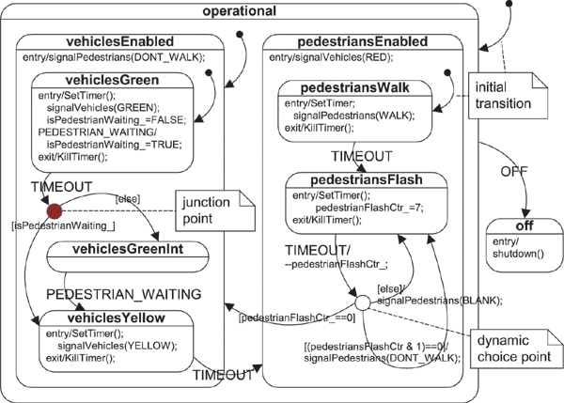
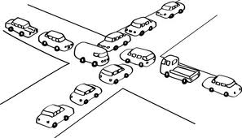
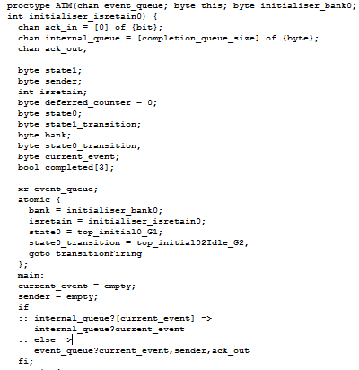
Background
Formal semantics needed
Verfication tools
We are devoted to solve the problem of automatic verification, especially model checking of UML state machine models.
Notes:
Let’s illustrate this (the third point) a bit more.
In a model-driven development process, given a system to be developed, system designers usually sit together with stake holders to discuss requirements.
Then graph modelling languages such UML state machines are used to model the dynamic behaviours of the system.
In the model, we want to make sure that good properties are preserved and bad properties, such as this deadlock situation in a traffic control system, does not occur. This is tedious for manual detection since all execution traces need to be explored.
But existing formal verification techniques such as model checking, is indeed good at finding such design flaws.
In model checking, the system as well as the property to be checked are formalized in certain kind of formal languages first and then put into corresponding model checkers to do the verification. Then conterexample will be returned if there exist one.
In order to provide automatic verification support for UML state machines, we need to bridge the gap either indirectly or directly, we will explain more on this later. Either way, a formal semantics which is unambiguous is necessary.

Slide 4
Related Work
Translation Based approach
Verification tools
Notes:
There are a lot of works focusing on this problem published during the past 15 years.
We roughly categorize those approaches into two categories, i.e., Translation-based approaches
and directly providing operational semantics for UML state machines.
Translation-based approaches provide translation
rules which convert UML state machines into some target formal languages. This kind of works are considered as an indirect approach since they utilize
the tool support for the target languages to do model checking on UML state machines.

Slide 5
Related Work
Translation-based approach: convert UML state machines into some formal language.
Existing works:
[BCR’00, BCR’03] translate UML state machines into Abstract State Machines.
[CKZ’11, ACK’12] translate UML state machines into Petri Net.
[LMM’99Spin, SKM’01] translate UML state machines into Promela.
[NB’03, ZL’10] translate UML state machines into CSP and CSP#.
Weaknesses:
Redundant but undesired behaviors may be introduced due to the semantic gaps.
Heavily depends on the target language and fragile to changes.
Knowledge of the target language may be required.
Notes:
There are a lot of works published in this category, here we selectively list some of the representative ones.
Borger et.al. proposes to translate UML state machines into ASM. Christine et.al. translates UML state machines into
Petri Net. Latella and Schafer propose to translate UML state machines into promela, the input language of Spin model checker.
Butler, Z,L propose to translate UML state machines into CSP(FDR), CSP#(PAT) respectively.
Though different target formal languages are chosen, this kind of approaches share some common weaknesses.
Firstly, due to the semantic gaps between UML state machines and the target formal language, some features are hard to translate and redundant but undesired behaviours may be introduced during the translation procedure.
Secondly, this kind of approaches heavily depends on the target formal language as well as the tool support for those languages.
And they are fragile to changes and updates of those languages and tools.
Thirdly, due to the second defaults, knowledge of the target language as well as tool supports may be required for the users
To use those tools.
CPN-AMI, MC with PROD, Helsinki Technology University

Slide 6
Related Work
Verification tools

Slide 7
Related Work
Operational Semantics for UML state machines
Verification tools
Notes:
The second category includes the works that directly provide operational semantics for UML state
Machines, which enables directly model checking of UML state machines.

Slide 8
Related Work
Operational semantics for UML state machines
Existing works:
[LMM’99] uses EHA as intermediate format and LTS as semantic model.
[Beeck’02] inspired by [LMM’99], use LTS as semantic model.
[FS’07] use core state machine as semantic model.
Weaknesses:
[LMM’99][FS’07] Intermediate formats are used.
Only covers a subset of UML state machine features.
It is not clear how to extend the work[LMM’99][Breek’02] to support more features, such as choice, fork, join pseudostates.
Syntax structure does not obey OMG UML state machine specifications.
Notes:
We list some approaches which are representative and inspire our work.
Latella et.al. propose to formalize UML state machines with LTS as semantic model. They use an intermediate
Format called EHA, which extends HA to supported transitions that cross state hierarchies.
Beeck’s work follows the idea of Latella, in which he also use LTS as the semantic model. But no intermediate
Format is used in his work. Instead, he directly uses terms to represent the syntax structure of UML state machines.
Fecher et.al. proposes to formalize UML state machines with core state machines. The core state machine is just a
Subset of UML state machine. The work provided the formal semantics in the form of inference rules for core state machines,
Then they provide (informally) transformation rules form the remaining set of UML state machine features to core state
Machines. The transformation rules are informally described with natural language and example illustration.
There are still some weaknesses in this kind of approaches.
Firstly, in some works, intermediate formats are used, which may potentially make these works share some common weaknesses
With those translation based approaches.
Secondly, these approaches only coves a subset of UML state mahcine features and it is not clear how to extend those approaches
To support more features.
Lastly and most importantly. The syntax structures adopted by those approaches do not obey the syntax structure provided
By UML state machine specification. They either use some intermediate format,
Which vary a lot from UML state machines, or flatten the original hierarchical structure of UML state machines.
UML state machines specificatoins have defined formal syntax, coming with OCL constrained which guarantees the
Well-formedness of the models. We believe that preserving the original syntax can make the overall definition
Adpate better to furhter changes.

Slide 9
Our Contributions
An operational semantics for complete UML state machines (v2.4.1), inspired by previous works [LMM’99] [Beeck’02] .
Syntax structure follows OMG UML state machines specifications.
Complex features such as orthogonal composite state, submachine state, fork/join/choice pseudostates.
Communications (synchronous and asynchronous) between different state machines.
Formalize event pool mechanisms.
Implementation of the operational semantics in a prototype tool, which facilitates model checking of safety and liveness properties on UML state machines.
Notes:
In this work, we present an operational semantics for UMLv2.4.1 state machines, which is recently made a standard by the international standard organization. Our work is inspired by previous approaches by Latella and Beeck, in the sense that
We adopt LTS as our semantic domain. This is also motivated by our goal of explicit model checking support for UML state machines.

Slide 10
Our Contributions
1. Operational semantics
Covers all features of UML
State machines, communications
and event pool mechanisms
USM²C
2. A self contained UML state machine model checker
Notes:
With our contribution, direct model checking for UML state machines is made possible and more efficient.

Slide 11
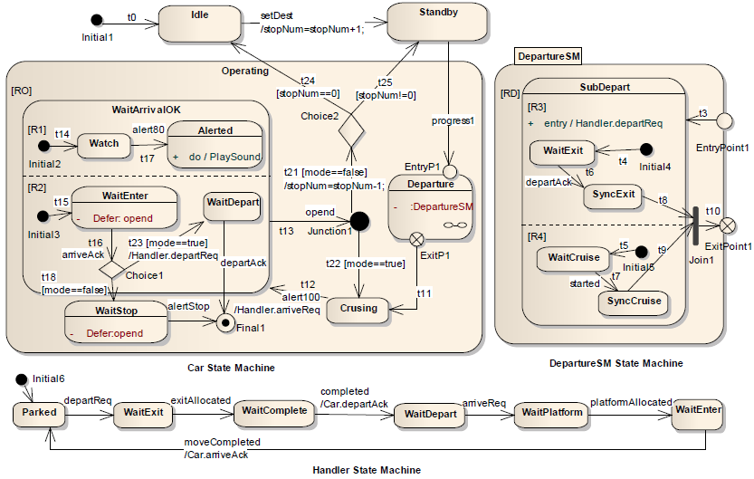
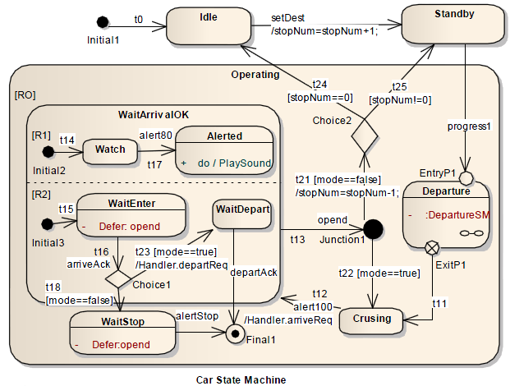
Preliminary
State
Simple, Composite
Orthogonal, Submachine
Region
Transition
Pseudostate
Fork, Join, Junction, Choice
Initial, Entry, Exit, Terminate,
Shallow history, Deep history
Compound Transition
Run to completion (RTC) step
D.Harel and E.Gery, Executable Object Modeling with Statecharts. In IEEE Computer, volume 30, pages 31-42

Slide 12
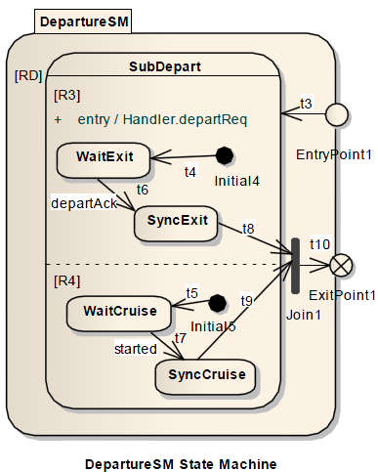
Our Approach--Syntax
Follow UML state machines specifications
A tuple contains all the attributes and associations
Extends well to future changes, i.e., refinement.
Example
DepartureSM = ({RD}; {EntryPoint1; ExitPoint1})
Further refinement to region RD or any attributes of RD will not change DepartureSM

Slide 13
Semantics—RTC rules
Use Labeled Transition System (LTS) as semantic model
(ks----current active states, P----current event pool, GV----global variables)
RTC Wandering Rule
RTC Deferral Rule 1
RTC Deferral Rule 2
RTC Progress Rule
RTC ProgressC Rule

Slide 14
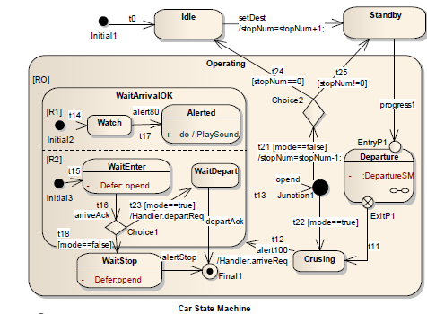
Semantics—RTC rules (illustration)
Example
({Crusing, Operating},
(Φ, Φ, {alert100}),
{stopNum=1, mode=true})
alert100 (RTC Progress Rule)
({Watch, WaitEnter, WaitArrivalOK,Operating},
(Φ, Φ, {opend , arriveAck}),
{stopNum=1, mode=true})
arriveAck (RTC ProgressC Rule)
opend (RTC Deferral Rule 2)
({Watch, Choice1, WaitArrivalOK,Operating},
(Φ, Φ, {opend}),
{stopNum=1, mode=true})
[mode==true]
({Watch, WaitEnter, WaitArrivalOK,Operating},
(Φ, {opend} , {arriveAck}),
{stopNum=1, mode=true})
({Watch, WaitDepart, WaitArrivalOK,Operating},
(Φ, Φ, {opend}),
{stopNum=1, mode=true})

Slide 15
Semantics--communications
Communications between different state machines
SendSignal indicates asynchronous communication
Call indicates synchronous communication

Slide 16
Semantics--communications (illustration)
(({Watch, WaitEnter, WaitArrivalOK, Operating},
(Φ, Φ, {alert80}), {stopNum=1, mode=false}),
({WaitEnter}, {Φ, Φ, {moveCompleted}} , Φ))
alert80 (RTC Progress Rule)
moveCompleted (RTC Progress Rule)
(({Alerted,WaitArrivalOK,
WaitEnter, Operating},
(Φ,Φ,Φ),{stopNum=1,mode=false}),
({WaitEnter}, {Φ, Φ, {moveCompleted}} , Φ))
(({Alerted, WaitEnter, WaitArrivalOK,Operating},
(Φ, Φ, {alert80}), {stopNum=1, mode=false}))
moveCompleted (RTC Progress Rule, RTC ProgressC Rule)
[mode==false]
(({Final1,Operating}, (Φ, Φ, {alert80}),
{stopNum=1, mode=false}))
({Watch, Choice1, WaitArrivalOK,Operating},
(Φ, Φ, Φ), {stopNum=1, mode=false})
alert80 (RTC Progress Rule)
[mode==false]
alertStop (RTC Progress Rule)
(({WaitStop,Operating}, (Φ, Φ, {alertStop})),
({Parked}, {Φ, Φ, Φ} , Φ))
(({Final1,Operating}, (Φ, Φ, Φ),
{stopNum=1, mode=false}),
({Parked}, {Φ, Φ, Φ} , Φ))
Handler state machine

Slide 17
Implementation and Evaluation
USM²C, a model checker for UML state machines.
Support model checking of safety and liveness properties.
Comparison with HUGO¹
Prop1=[](alert100→<>arriveAck),
Prop2=[](retain→(!cardValid /\ numIncorrect>=maxNumIncorrect))
Prop3=[](TurnGreen →<>carExit)
Scalability Evaluation Result
1. http://www.pst.informatik.uni-muenchen.de/projekte/hugo/index.html

Slide 18
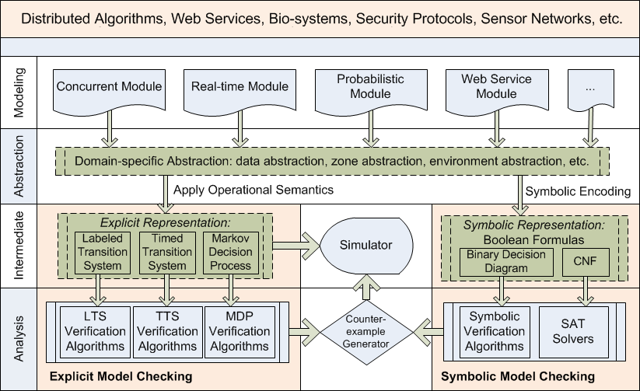
UML @ PAT
UML Module

Slide 19
Conclusion and Future work
Conclusion
Operational semantics coving all features of UML (v2.4.1) state machines.
Communications, event pools are considered.
Implementation and evaluation shows the effectiveness of our approach.
Future works
Action language can be formalized.
Consider real-time features.
Consider object-oriented features, such as object construction and destruction.
State space reduction techniques can be developed.

Slide 20
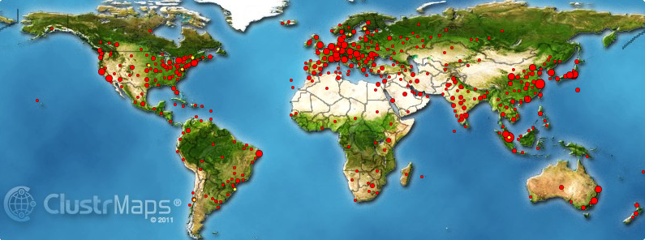
PAT—current status
PAT is available at http://www.patroot.com
1Million lines of code, 11 modules with 100+ build in examples
Used as an educational tool in many universities.
Attracted more than 2600 registered users from more than 600 organizations, e.g. Microsoft, HP, ST Elec, Oxford Univ., … Sony, Hitachi, Canon.
Japanese PAT User group formed in Sep 2009:

Slide 21
Thank you

Slide 22
References
[FSKR’05] H.Fecher, J. Schonborn, M. Kyas and W.P. de Roever. 29 new unclarities in the semantics of uml 2.0 state machines. In Formal Methods and Software Engineering. Pages 62-65, 2005.
[BCR’00] E. Börger and A. Cavarra and E. Riccobene. Modeling the Dynamics of UML State Machines. Abstract State Machines, Theory and Applications. Pages 223-241, 2000.
[BCR’03] E. Börger and A. Cavarra and E. Riccobene. Modeling the Meaning of Transitions from and to Concurrent States in UML State Machines. In proceedings of the 2003 ACM symposium on Applied computing. pages 1086-1091, 2003.
[CKZ’11] C. Choppy, K. Klai and H. Zidani. Formal Verification of UML State Diagrams: A Petri net based Approach. ACM SIGSOFT Software Engineering Notes. volume 36, issue 1, pages 1-8 , January 2011.
[ACK’12] E. André, C. Choppy and K. Klai. Formalizing Non-Concurrent UML State Machines Using Colored Petri Nets. ACM SIGSOFT Software Engineering Notes, volume 37, issue 4, pages 1-8 , July 2012 .
[LMM’99Spin] D. Lattela, I. Majzik and M. Massink. Automatic Verification of a Behavioural Subset of UML Statechart Diagrams Using the SPIN Model-checker. In Formal Aspects of Computing, volume 11, pages 637-644, 1999.
[SKM’01] T. Schäfer and A. Knapp and S. Merz. Model Checking UML State Machines and Collaborations. Electronic Notes in Theoretical Computer Science, volume 55, issue 3, pages 357–369 , October 2001.
[NB’03] M.Y. Ng and M. Butler. Towards formalizing UML State Diagrams in CSP. 1st IEEE International Conference on Software Engineering and Formal Methods. Pages 138-147 , 2003.

Slide 23
References
[ZL’10] S. Zhang and Y. Liu. An Automatic Approach to Model Checking UML State Machines. Secure Software Integration and Reliability Improvement Companion (SSIRI-C), pages 1-6, 2010 .
[LMM’99] D. Lattela, I. Majzik and M. Massink. Towards A Formal Operational Semantics for UML Statechart Diagrams. Proceedings of the IFIP TC6/WG6, 1999.
[Beeck’02] M. von der Beeck. A Structured Operational Semantics for UML-statecharts. In Software and Systems Modeling, volume 1, pages 130-141, 2002.
[FS’07] H. Fecher and J. Schönborn. UML 2.0 State Machines: Complete Formal Semantics Via core state machine. In Formal Methods: Applications and Technology, volume 4346, pages 244-260, 2007.

Slide 24
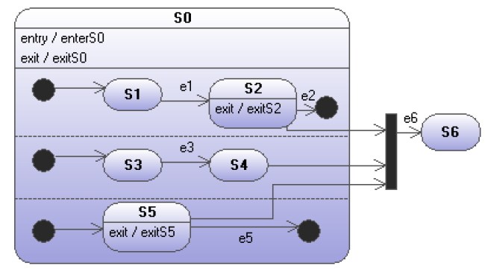
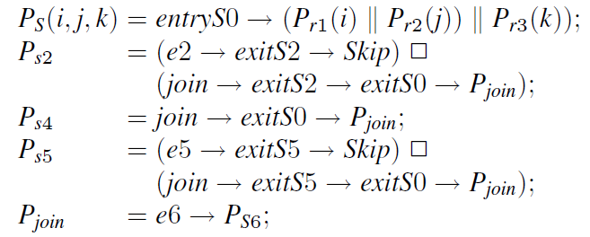
Backup I

Slide 25
Backup II

