Slide 1
PAT 3: An Extensible Architecture for Building Multi-domain Model Checkers
Yang LIU
Senior Research Scientist
National University of Singapore
(joint work with Jun SUN and Jin Song DONG and
PAT research team)

Slide 2
Model Checking
Determining whether a model satisfies a property by the means of exhaustive searching (fully automatic)
The main disadvantage : state explosion problem!
Model
Model Checker
Property
Counterexample!

Slide 3
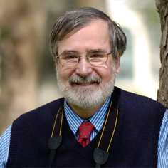
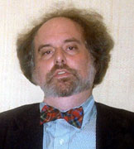
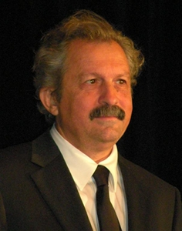
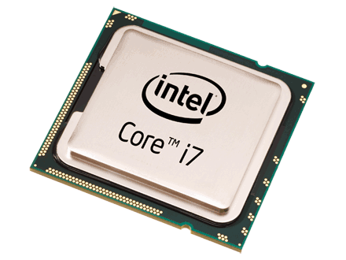
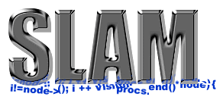
Model Checking Works!
Notes:
Three researchers won Turing Award 2007 for their pioneer work on model checking!
Intel i7 processor is verified by symbolic model checking completely without executing a single test case!
The Slam project from Microsoft successfully detected many bugs in many driver software!

Slide 4
Challenges of applying model checking
Using existing model checkers
Steep learning curve
Existing model checkers may be inefficient or insufficient
E.g. multi-party barrier synchronization is difficult in SPIN
Translation to existing tools may often be ad hoc.
Extending existing model checkers
Model checker’s code is complicated
Developing a new model checkers
Complicated functions:
language parsing, system simulation, verification algorithms, state reduction techniques and counterexample generation and display
Decades of efforts to build a solid model checker

Slide 5
PAT (Process Analysis Toolkit)
An self-contained framework to support the development of formal verification tools
A wide range of systems
Concurrent, real-time and probabilistic systems
Extensible architecture
Modular design
10+ Modules for different application domains
Various model checking techniques
Explicit model checking
Symbolic model checking
Assume-guarantee model checking
…
www.patroot.com

Slide 6
The Current Status
5 Years Development
National University of Singapore
Singapore University of Technology and Design
PAT research team (~ 30 persons):
3 Faculty + 6 post doc + 15 ph.d. + 5 RA
1 Million lines of code, 11 modules with 100+ build in examples
Attracted more than 1500 registered users in the last 5 years from more than 400 organizations, e.g. Microsoft, HP, ST Elec, Oxford Univ., … Sony, Hitachi, Canon.
Used as an educational tool in many universities.
Japanese PAT user group formed in Sep 2009:
Founding Members:
Hiroshi Fujimoto
Nobukazu Yoshioka
Toshiyuki Fujikura
Kenji Taguchi
Masaru Nagaku
Kazuto MATSUI
6

Slide 7
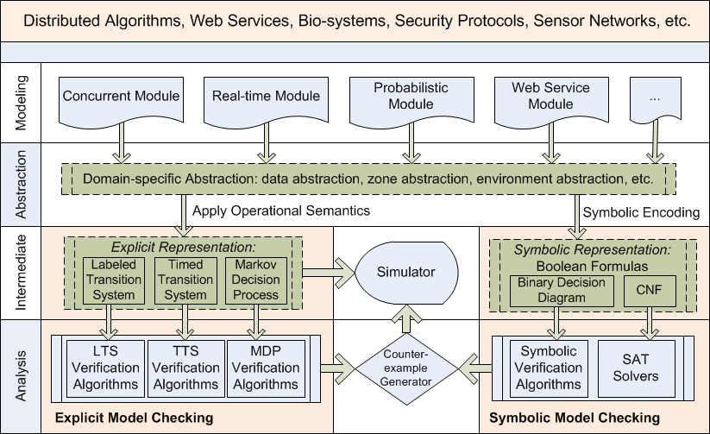
PAT System Design

Slide 8
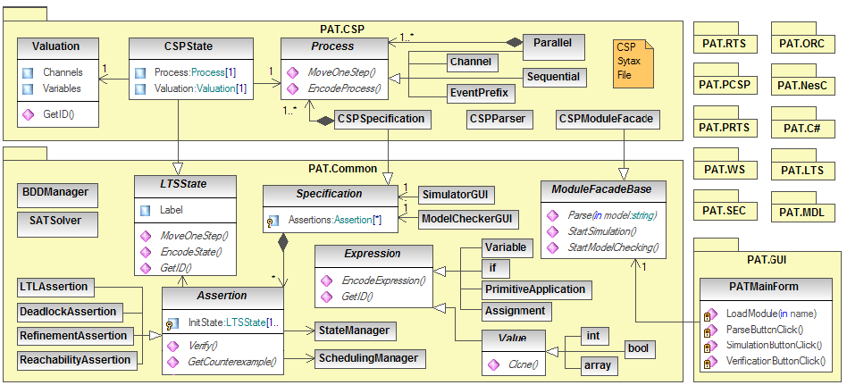
Class Diagram

Slide 9
PAT Extensibility
Translate external models into existing languages in PAT through module APIs.
Promela to CSP#, State diagram to CSP#
Extend the existing modeling languages with new syntax, data types or libraries.
Set, Queue, Hashtable…
Extend PAT with domain specific model checking algorithms, state reduction techniques or abstraction techniques.

Slide 10
Build a Model Checker
Define Syntax
Define Semantics
Property
Language
Visualize
Trace
Develop MC Algorithms
Optimization

Slide 11
Build a Model Checker with PAT
Module Generator tool: to generate the code skeleton
Current modules that are under development
Timed Automata (1 month time)
Labeled Transition Systems (2 month time)
Software Architecture Description language (1 month time)
Define Syntax
Define Semantics

Slide 12
PAT’s Technical Contributions
Featured modeling languages
A number of verifications techniques
Fast LTL model checking with fairness assumption (CAV 2009)
Fast trace refinement checking (Isola 2008)
Real-time abstraction techniques
Zone abstraction (FSE 10)
Non-zeno behaviors (TOSEM 11)
Assume-guarantee reasoning techniques (ATVA 2011)
Develop different reduction techniques
Symmetry reduction (FM 2010)
Process counter abstraction (FM 2009)
(Dynamic/compositional) partial order reduction (ICFEM 2011)
Symbolic model checking libraries for hieratical systems (ASE 2011)
PAT Languages = Hoare’s CSP + Data + Real-time + Probability

Slide 13
PAT vs. other tools
Tool | Hierarchy | Data Operation | Real Time | Prob. | Concurrecy
SPIN | x | ☺ | x | x | ☺
UPPAAL | x | ☺ | ☺ | x | ☺
PRISM | x | x | x | ☺ | ☺
NuSMV | ☺ | x | x | x | ☺
FDR | ☺ | x | x | x | ☺
LTSA | x | x | x | x | ☺
PAT | ☺ | ☺ | ☺ | ☺ | ☺
PAT is more than one model checker, rather it is a
framework for realizing system verification techniques.

Slide 14
Demonstration

Slide 15
PAT Applications
Model-base Testing
Model checking as planning/service
Automatic Generation of Provably Correct Embedded Systems

Slide 16
Model Based Testing and Checking
Test cases are difficult to write
Complete Coverage
Tedious to update if code is changed
A better and simpler way to write test cases: combine Contracts with CSP
Code contracts take the form of object invariants, method precondition and post-conditions
They are used to improve testing via runtime checking as well as enable static contract verification
Testing plan is written using elegant high-level CSP code
Demo of Testing using DBM

Slide 17
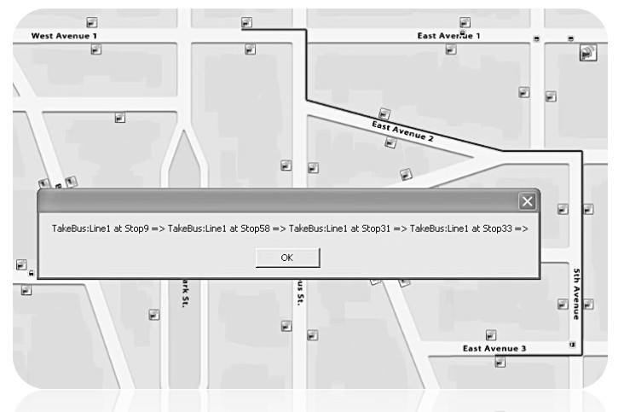
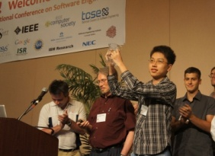
Model Checking as Planning/Scheduling/Service: Transport4You, an intelligent public transportation manager ICSE 2011 SCORE Competition Project (PAT won FM Award)
PAT model checker is used not only as a verification tool for the system design but also as a service that computes an optimal travel plan.
94 teams from 48 universities in 22 countries started the competition; 55 finished and made final submission; 18 teams were selected for the second round; 5 finalist teams invited to Hawaii with 2000USD travel award for each team. Two winners (Formal Methods Award and Overall Award) were selected during the conference.
PAT student team won Formal Method Award

Slide 18
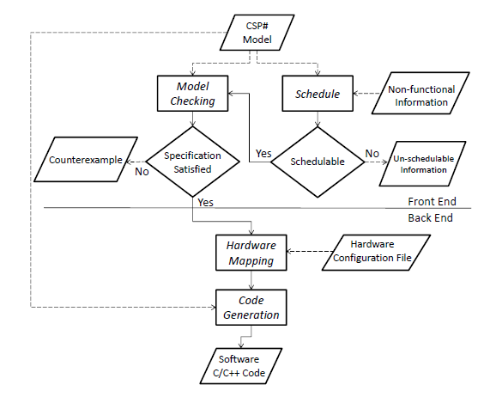
Automatic Generation of Provably Correct Embedded Systems

Slide 19
Ongoing Works – New Domains
Security protocol (in design phase)
TPM?
Web Service (Orc language/BPEL language) (in implementation)
Sensor networks system written in NesC (in optimization)
Distributed algorithms
Context-aware systems (in design phase)
UML (or FUML) diagram (in design phase)
Software Architecture Description Language (in implementation)
Event Grammar /ADL
Verification of C# Programs (in progress)
Assembly Code Verification (in implementation)
BitBlaze-Vine IL
Multi-agent Systems (in progress)
Notes:
CSF: Computer Security Foundations Symposium
, CSS, ESORICS, S&P
CCS: ACM Conf on Comp and Communications Security
European Symposium on Research in Computer Security

Slide 20
Ongoing Works – Mode Checking Techniques
Automatic symmetry detection and reduction (in design phase).
Probabilistic / Stochastic Model Checking (in implementation)
Symbolic modeling checking library (using BDD) for hierarchical systems
CSP/LTS (in testing phase)
TA/RTS (in implementation phase)
Assume-guarantee verification (in implementation)
Multi-core model checking algorithms and swarm verification techniques (in implementation)

Slide 21
Ongoing Works – Miscellaneous
Code generation from PAT models to C/C++ code for embedded system or mobile applications (in design phase)
UTP language semantics of the PAT modeling languages (draft done)
Visual Studio/Eclipse integration of PAT to allow users to link the source code with PAT for the direct verification of source code level. (first proto-type is done)
Comparison with existing model checkers
FDR (CSPm) / ProB
CADP (Lotos NT)
SPIN
PRISM

Slide 22
PAT’s Goals
We not only aim to develop a verifier, but rather to build a framework for realizing system verification techniques
Model checking techniques: EMC, SMC (SAT/BDD/SMT), A-G, CEGAR
Different domains: web services, sensor network, distributed algorithms, bio, security,
Different semantics model: LTS/TTS/MDP/TA/PTA…
Different algorithms: LTL/Refinement/Multi-core..
Different reduction techniques: POR, Symmetry detection and reduction, process counter abstraction
Applications of model checking: testing, planning, SE (reliability/product line/software-eco systems…)
Pervasive Model Checking
Notes:
PAT is a self-contained, extensible and modularized multi-domain model checking systems for composing, simulating and reasoning of concurrent, real-time, probabilistic systems and other possible domains (i.e. distributed algorithms, security protocols, web services, sensor networks, etc).

Slide 23
Thank You!
Questions?
Please try PAT 3.4.1 at www.patroot.com
Postdoc Research Fellow Positions on Model Checking on Security Verification are Available!
High salary: up to 70,000 USD per year
email me: liuyang@comp.nus.edu.sg

Slide 24
SPIN 5.2.5 April 17 2010
SPIN was developed at Bell lab.
SPIN is the most popular model checker!
SPIN is initially designed for formal verification of communicating protocols.
The input language is Promela.
SPIN works by generating model-specific C programs which contains all possible system scheduling.

Slide 25
PAT vs SPIN: Modeling
A SPIN model is the parallel composition of multiple finite-state machines.
PAT supports more than one modeling language.
LTS – closest to Promela
CSP# - fully hierachical
RTS – CSP# + real-time
PCSP# - CSP# + probabilistic choices
PRTS – CSP# + real-time + probabilistic choices
…

Slide 26
PAT vs SPIN: Efficiency
For systems which are modeled in Promela and CSP#, SPIN is probably faster in same cases – not always! Why?
SPIN generates model specific C programs – optimization may be applied during the process.
A configuration in SPIN is of the form (V, Sp1, Sp2, …) where V is the variable valuation; Sp1 is the state of the process 1; Sp2 is the state of the process 2.
A configuration in PAT with CSP# is of the form (V, P) such that P is a process.

Slide 27
PAT vs SPIN: Efficiency (cont’d)
SPIN supports
Partial order reduction
Parallel model checking
PAT supports
Partial order reduction – not any more!
Manual partial order reduction through keyword atomic
Symmetry reduction
BDD – finished for LTS, in progress for CSP#

Slide 28
PAT vs SPIN: Others
SPIN supports LTL whereas PAT supports SE-LTL.
SPIN supports embedded C program (in an odd way), whereas PAT supports arbitrary C# data types or static methods.
PAT supports refinement checking whereas SPIN does not.
PAT supports a variety of fairness whereas SPIN does not.

Slide 29
PAT vs SPIN: GUI
Once you tried both PAT and xSPIN, you will know.
SPIN is probably more efficient for networks of
concurrent processes and LTL properties without
fairness; If your system is hierarchical, timed, or
probabilistic, or your property is liveness requiring
fairness, or you like better simulation, go for PAT.

Slide 30
Alloy Analyzer May 21st 2006
Alloy analyzer was developed at MIT.
Alloy analyzer essentially solves a different problem.
Model checking: given a model, check whether the model satisfies certain property.
Alloy analyzer: given a set of constraints (in the form of a declarative model), check whether there exists a model which satisfies the constraints.
Alloy analyzer’s problem is harder whereas model checking more practical.
If you have a model checking problem, go for PAT.

Slide 31
FDR 2.83 July 23 2007
FDR was developed at Oxford university.
FDR is a dedicated model checker for Hoare’s CSP.
FDR models fully hierarchical systems.
It’s semantics is mostly compositional.
All inter-process communication is through barrier synchronization!
FDR verifies properties by establishing refinement relationship.

Slide 32
PAT vs FDR: Modeling
PAT supports inter-process communication through
Barrier synchronization
Shared variables
Synchronous/asynchronous channel communication
FDR doesn’t support shared variables!
PAT supports all assertions which are supported by FDR.

Slide 33
PAT vs FDR: Efficiency
FDR incrementally compile and compress processes.
It could check 10^20 dining philosophers if you model it correctly!
It supports other kinds of optimization including bi-simulation reduction and a partial order reduction like tau-transition reduction.
If the above optimizations do not work, PAT probably is fast.
Unless you are a real expert of CSP, be careful
should you choose FDR.

Slide 34
LTSA V3.0 June 2006
LTSA was developed at Imperial college.
LTSA is very much related to FDR or process algebra, yet it has its own features.
LTSA has no supports for variables.
LTSA supports a simple form of timing.
…
LTSA comes from a less formal background.

Slide 35
NuSMV 2.5
NuSMV is jointly developed by multiple universities.
Its input language was designed for hardware circuits.
It supports hierarchical systems in a different way.
It is based on symbolic model checking techniques.
BDD
SAT solving
NuSMV is designed for symbolic model checking.

Slide 36
UPPAAL 4.0
UPPAAL was developed jointly at Uppsala University of Aalborg University.
The input language of UPPAAL is Timed Safety Automata
Networks of finite-state automata with clocks
The property language of UPPAAL is a restrictive subset of Timed CTL.
UPPAAL is designed and optimized for simple
real-time systems.

Slide 37
PRISM 3.3.1 Nov 22 2009
PRISM was developed at University of Birmingham and now at Oxford University.
The input language of PRISM is a simple state-based language with probabilistic distributions
Markov chain, Markov Decision Process, CTMC
PRISM is designed and optimized for simple
probabilisitc systems.

