Slide 1
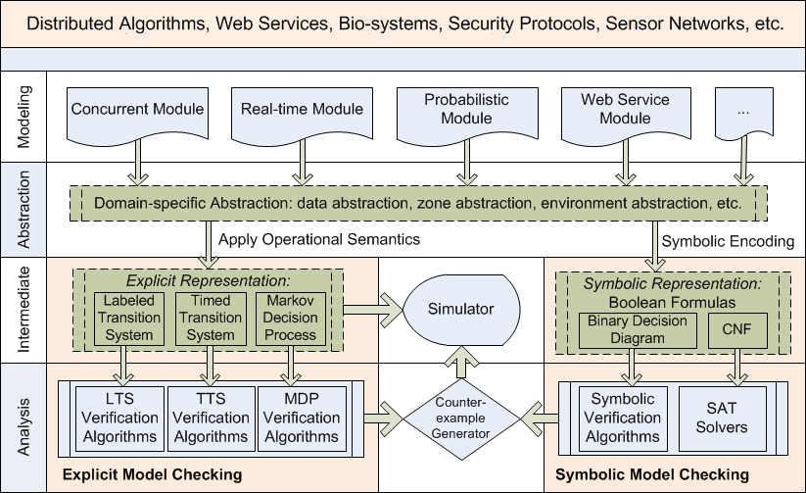
A Symbolic Model Checking Framework for
Hierarchical Systems
Truong Khanh Nguyen¹, Jun Sun², Yang Liu¹, and Jin Song Dong¹
¹ National University of Singapore
² Singapore University of Technology and Design
Introduction
Approach
Binary Decision Diagram (BDD) based model checking is capable of verifying systems with a large number of states. BDD is probably still the best choice for model checking. Implementing system verification methods based BDD is HARD!
Complex systems are often hierarchical, where high level system components are composed by sub-components in many different ways. We implemented a model checking framework to facilitate application of BDD technique for fully hierarchical systems.
We provide a unified solution in the PAT framework so that complicated hierarchical systems modeled using compositional languages can be encoded and verified symbolically with minimum knowledge on BDD encoding and implementation.
We provide a novel library of symbolic encoding functions which covers more than 30 common system composition functions, e.g., choice, parallel, iteration, etc. We developed three symbolic model checkers based on our framework within months.
Implementation& Evaluation
The BDD library is part of the PAT framework.
Website: http://www.patroot.com Email: pat@comp.nus.edu.sg

