Slide 1
Verifying Stateful Timed CSP using Implicit Clocks and Zone Abstraction
Jun Sun, Yang Liu, Jin Song Dong and Xian Zhang
School of Computing
National University of Singapore

Slide 2
PAT for Verifying Real-time Systems
Demonstration
http://pat.comp.nus.edu.sg

Slide 3
Motivation
Real-time system modeling and verification is dominated by Timed Automata
UPPAAL, KRONOS, RED, etc.
High-level requirements are often stated in terms of
deadline
timeout
timed interrupt

Slide 4
Contributions
A language for modeling compositional real-time systems using implicit clocks.
CSP + Data + Real-time
A method for abstracting and verifying the models.
Zone abstraction
LTL and refinement

Slide 5
System Model
A system model is a 3-tuple (Var, init, P).
A timed process P is defined by
Stop, Skip, e -> P
if b then P else Q, P [] Q, P <> Q
P; Q, P || Q, P interrupt Q
P = Q
Wait[d], P timeout[d] Q, P interrupt[d] Q
P deadline[d], P within[d]

Slide 6
Example
#define N 4; #define Delta 3; #define Epsilon 4; #define Idle -1;
var x = Idle; var counter;
P(i) = if(x == Idle) {
((update.i{x = i} -> Wait[Epsilon]) within[Delta]);
if (x == i) {
cs.i{counter++} -> exit.i{counter--; x=Idle} -> P(i)
}
else { P(i) }
}
else { P(i) };
FischersProtocol = ||| i:{0..N-1}@P(i);
#assert FischersProtocol |= [] (update.0 -> <> cs.0);

Slide 7
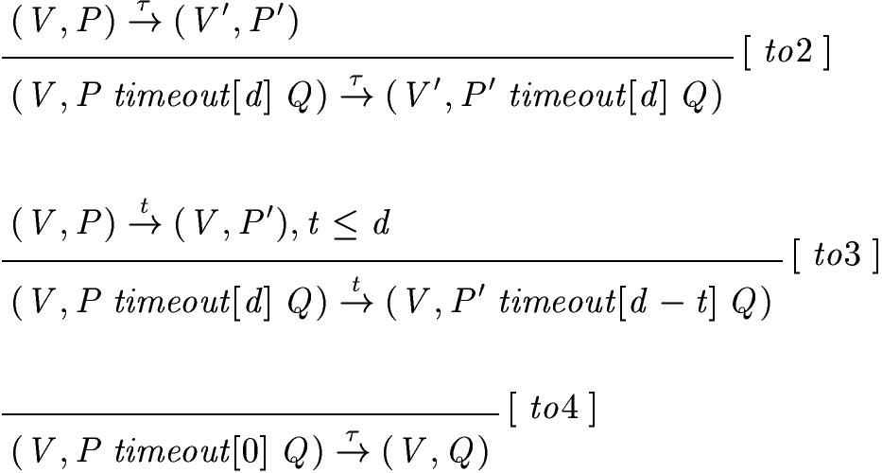
Operational Semantics
A system configuration is a pair (V, P) where V is the valuation of the variables and P is the current process expression

Slide 8
Zone Abstraction
Dynamically activate/de-activate clocks
Use a predicate to capture timing requirements
Use DBM to systematically solve the predicate

Slide 9
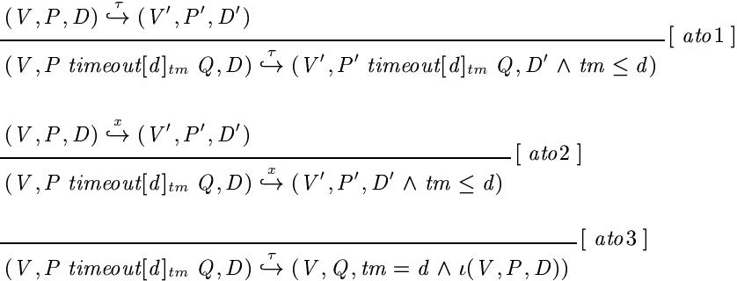
Abstract Operational Semantics
An abstract system configuration is a pair (V, P, D) where V is the valuation of the variables, P is the current process expression and D is a zone.

Slide 10
Example
Assume <t1,t2,t3,…> is a list of fresh clocks
Assume a model ({}, {}, P) where P is defined as follows,
P = (a -> Wait[5]; b -> Stop) interrupt[3] c -> Stop
Event b will never occur!

Slide 11
Example (cont’d)
check if a clock is needed, if yes introduce a clock
apply firing rules
By rule ait1: event a occurs
check if a clock should be de-activated
Process: (a -> Wait[5]; b -> Stop) interrupt[3] _t1 c -> Stop
Zone: t1 = 0
Process: (Wait[5]; b -> Stop) interrupt[3] _t1 c -> Stop
Zone: 0<= t1 <=3

Slide 12
Example (cont’d)
check if a clock is needed
apply firing rules
By rule ade1: event tau (due to Wait[5]) occurs
Process: (Wait[5]_t2; b -> Stop) interrupt[3] _t1 c -> Stop
Zone: 0<= t1 <=3 && t2 = 0 && 0<= t1-t2 <= 3
Process: b -> Stop interrupt[3] _t1 c -> Stop
Zone: 0<= t1 <=3 && t2 = 5 && 0<= t1-t2 <= 3

Slide 13
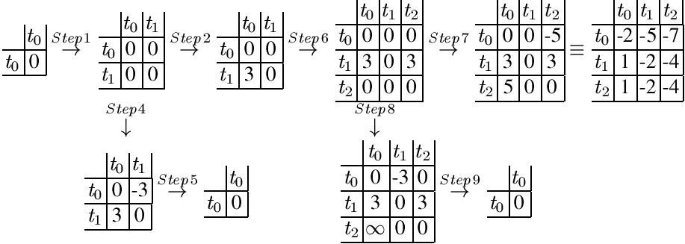
DBM

Slide 14
System Verification
The abstract transition system time abstract bi-simulates the concrete transition system.
LTL-X model checking is sound and complete.
Trace (or stable failures, failure/divergence) refinement checking is sound and complete.

Slide 15
Example: Refinement Checking
MutualExclusion = Relevant ||| Irrelevant;
Relevant = cs.0 -> exit.0 -> Relevant [] cs.1 -> exit.1 -> Relevant;
Irrelevant = update.0 -> Irrelevant [] update.1 -> Irrelevant;
#assert FischersProtocol refines MutualExclusion;
<…, cs.0, cs.1, …> or <…, cs.1, cs.o, …> is NOT a trace
of process MutualExclusion!

Slide 16
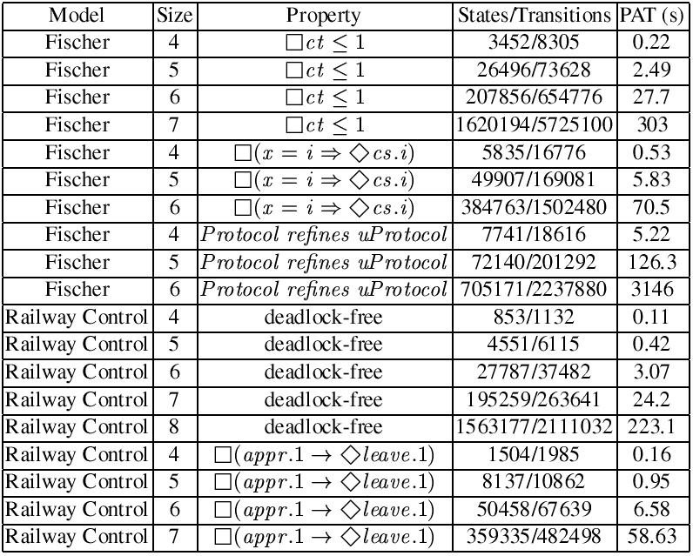
Experiments

Slide 17
Conclusion
PAT for verifying real-time systems
http://pat.comp.nus.edu.sg
Future works
Timed refinement checking (DONE!)
Probabilistic model checking in PAT (Partially DONE)
Symmetry reduction (ONGOING)

